Slide 1

BABU BANARSI DAS
INSTITUTE OF TECHNOLOGY
MINI PROJECT
E-COMMERCE WEBSITE
BTECH(COMPUTER SCIENCE AND ENGINEERING)
4TH YEAR(2022-23)
Amarjeet Gupta
Submitted to
Atul sir

Slide 2




INTRODUCTION
An e-commerce website for grocery is an online platform that allows costomer to purchase groceries and other household items over the internet.
Customers can search for products, add items to their shopping cart, and then complete the purchase.
using a variety of payment methods.
The website typically displays product information, such as images, descriptions, and pricing, and may also provide customer reviews, ratings.

Slide 3
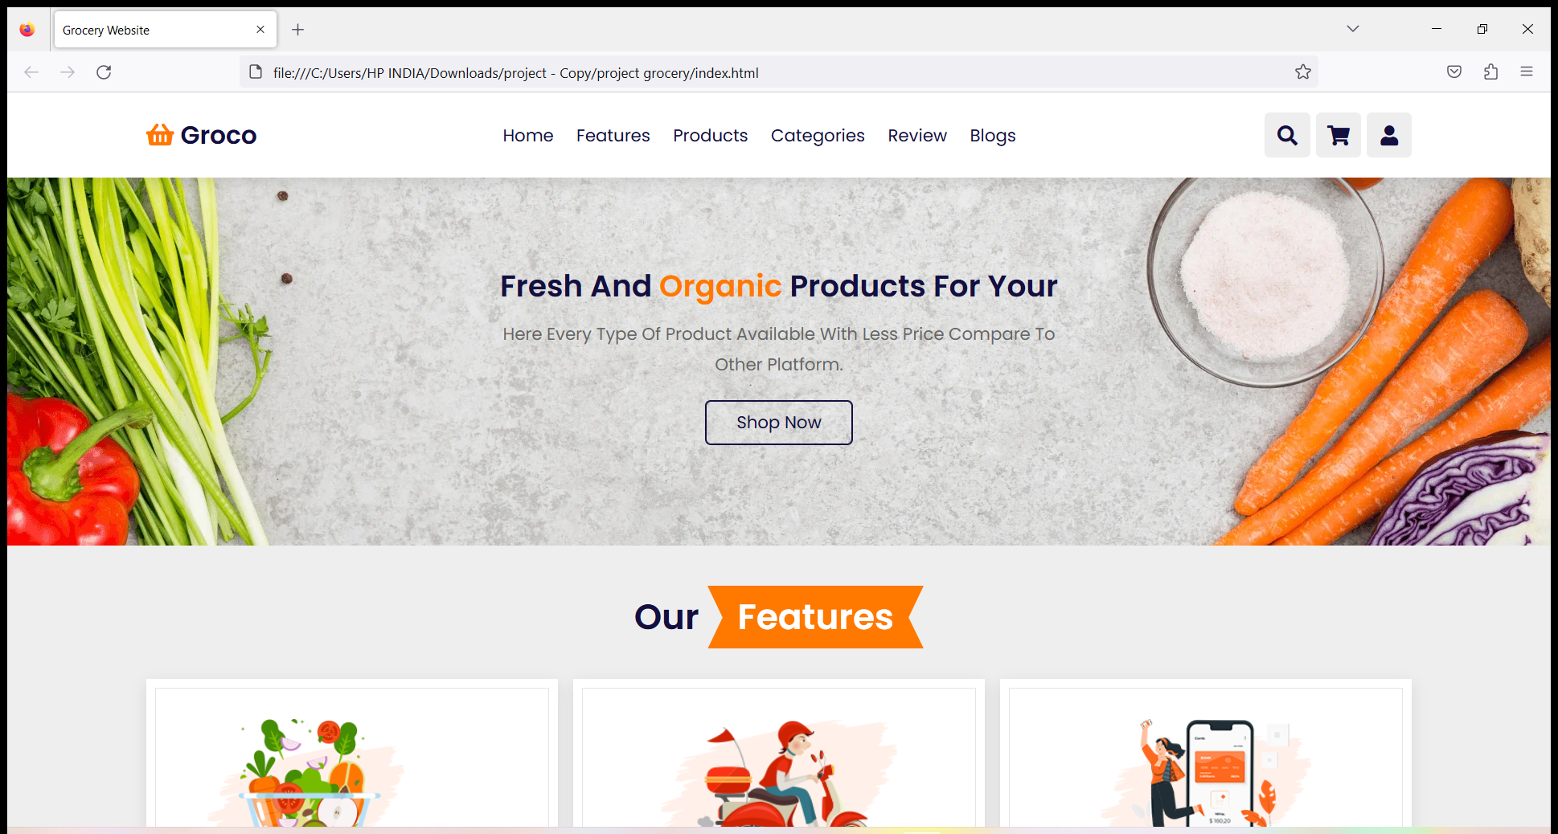
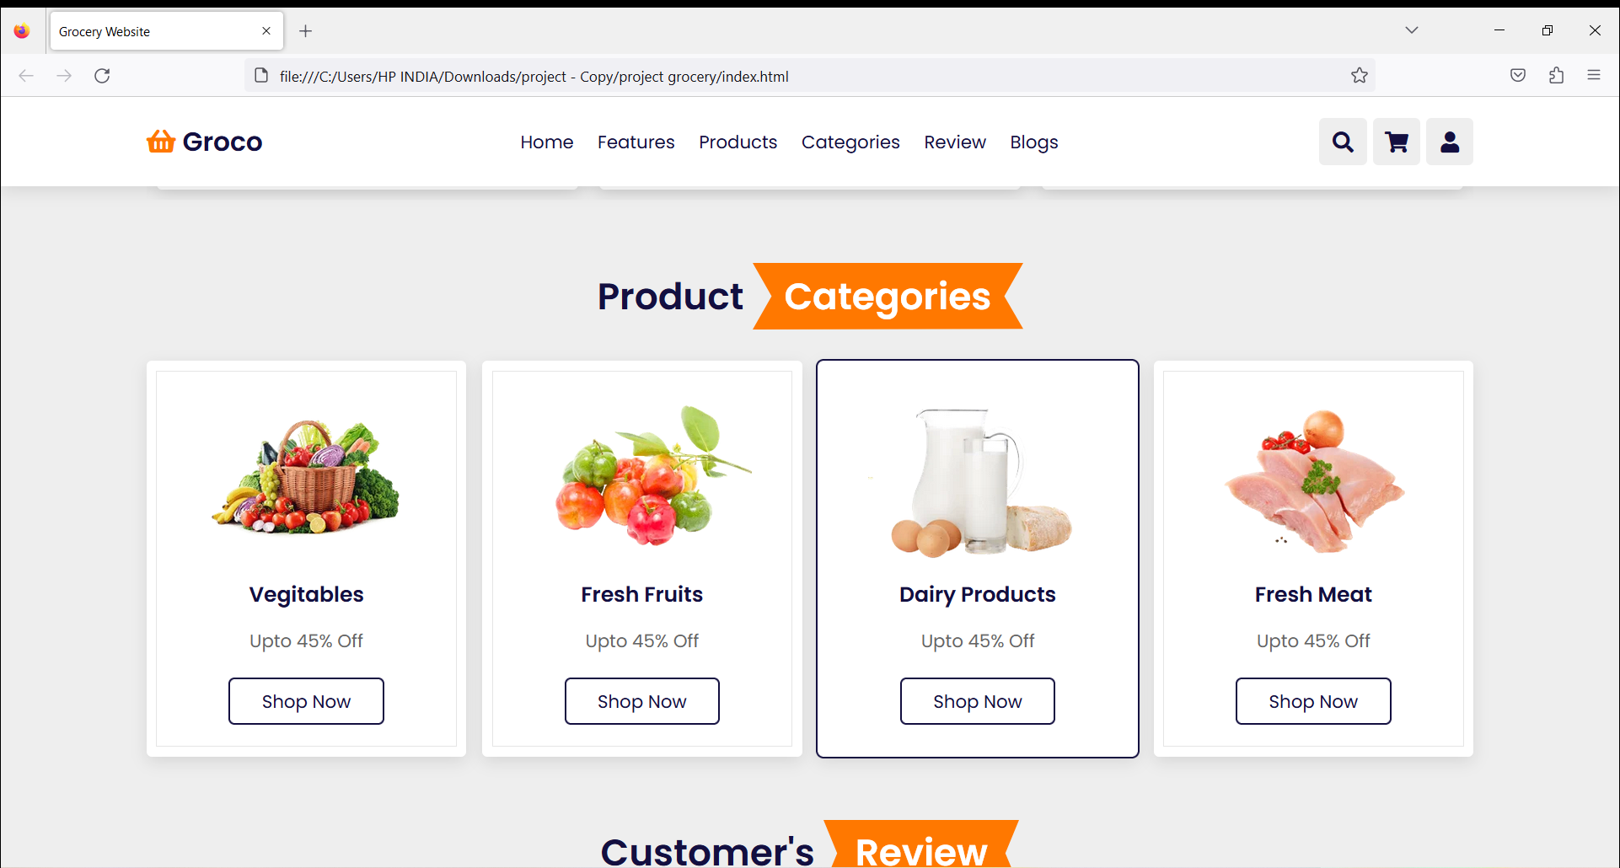
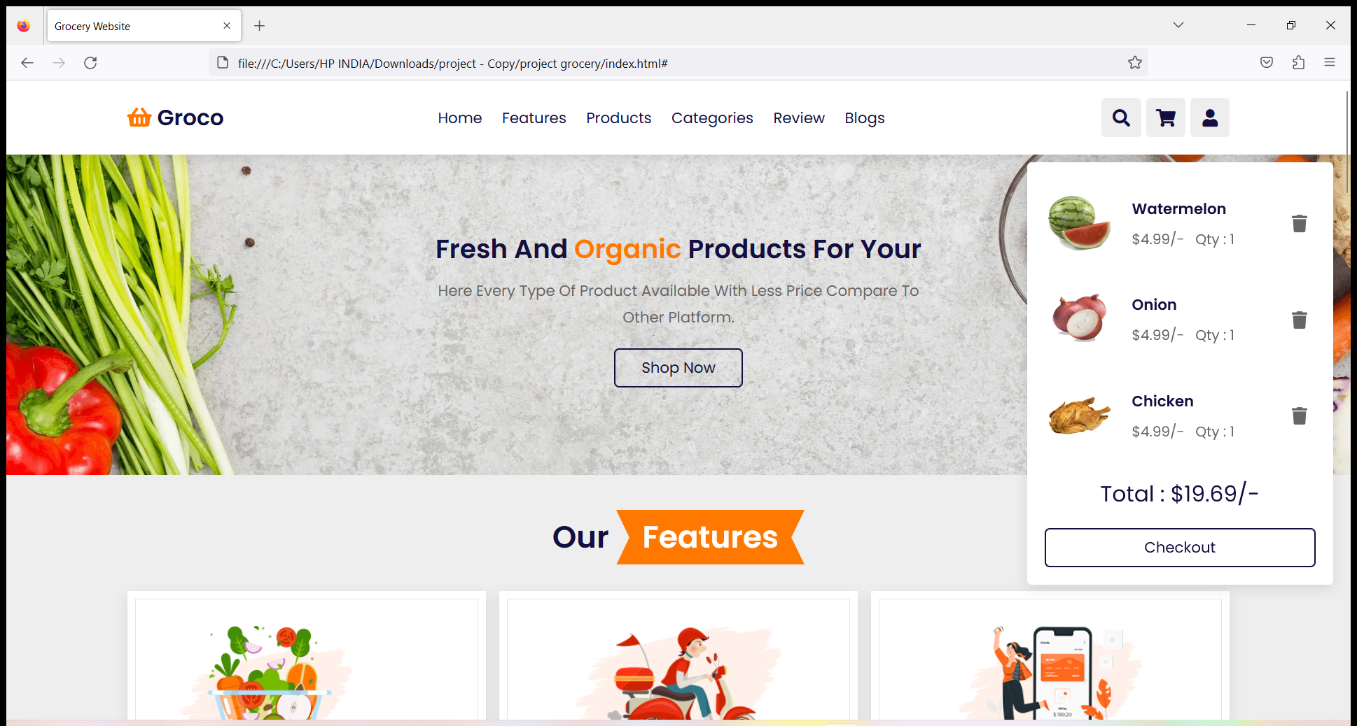
DESIGN AND FEATURE
user-friendly interface and navigation.
product categories, search bar, and filter options.
Home page Product pages shopping cart

Slide 4

Product selection and delivery
An e-commerce website for grocery typically has a wide selection of products available.
Information about delivery options, such as same-day or next-day delivery.
Images of products and delivery trucks.

Slide 5

Payment and security
Customers need to trust that their personal and financial information will be kept secure.
when they make a purchase, and that their payment will be processed accurately and efficiently.
One of the most common payment methods used on e-commerce grocery websites is credit or debit card payments, which encrypts the customer's sensitive information to protect it from intercepted by hackers.
To ensure security, e-commerce grocery websites may also implement several layers of protection, such as using Secure Socket Layer (SSL) certificates to encrypt data transmitted between the website and the customer's browser, and requiring customers to create strong passwords and use two-factor authentication to access their account.

Slide 6

conclusion
an ecommerce website is a powerful tool for businesses to sell their products and services online.
It allows for 24/7 availability, global reach, and the ability to easily track and analyze customer behavior.
Additionally, with the rise of mobile and social media usage, ecommerce has become even more convenient and accessible for both businesses and consumers.

Slide 7
Thank you

